Slide 1


Effects of code obfuscation and deobfuscation on machine-learning guided Android malware detection
Yanxin Zhang
School of Computer Science
Faculty of Engineering and IT

Slide 2
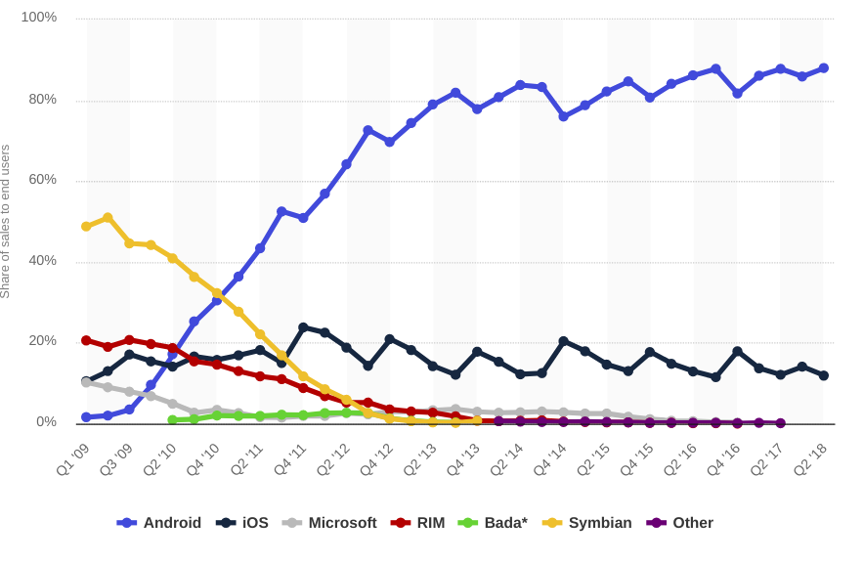
Background – Android OS

Slide 3

Background – Android OS

Slide 4
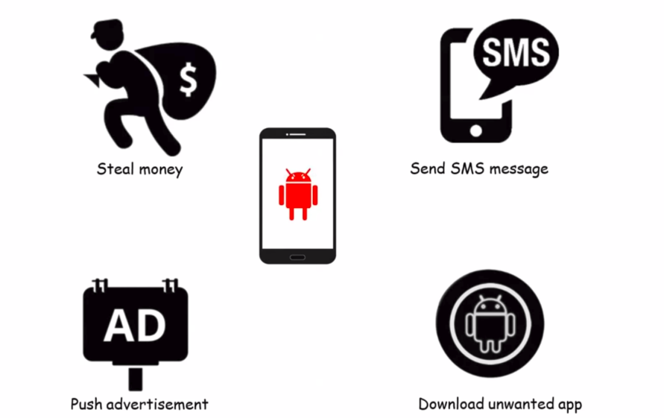
Background – Android OS

Slide 5
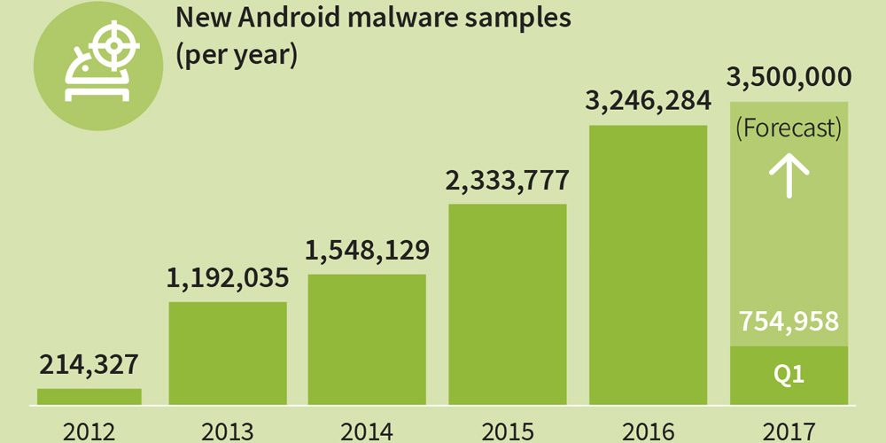
Background – Android OS

Slide 6
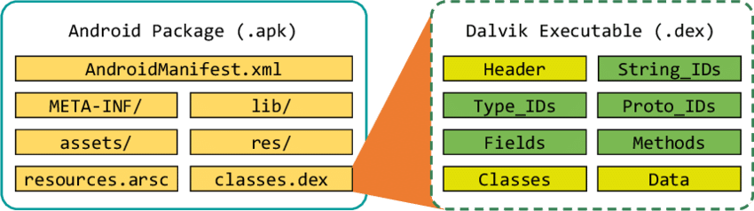
Background – Android malware

Slide 7
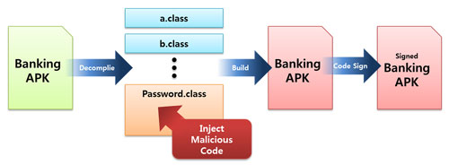
Background – Android Malware

Slide 8
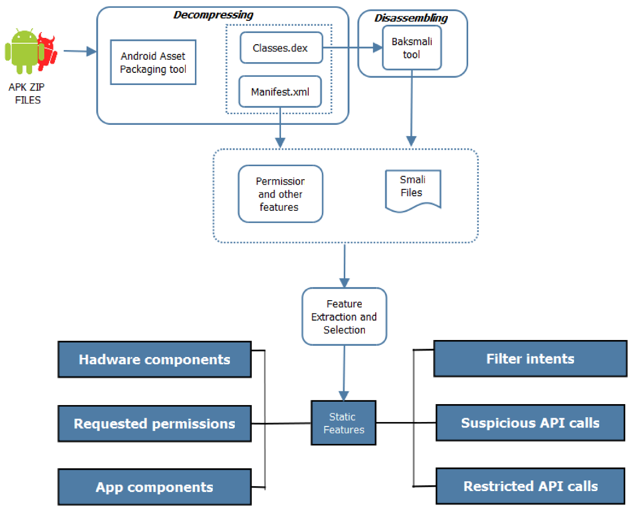
Background – Machine learning detection

Slide 9
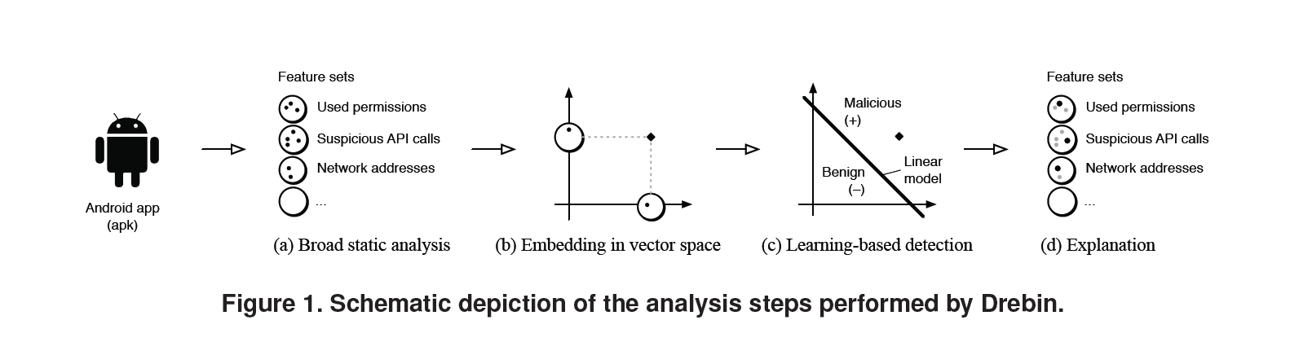
Background – Machine learning detection

Slide 10
Background - Obfuscation
Transforming a code into a form that is more difficult for humans, and possibly machines, to read, understand, and reverse engineer.
These transformations change the syntax of code but not their semantics.

Slide 11
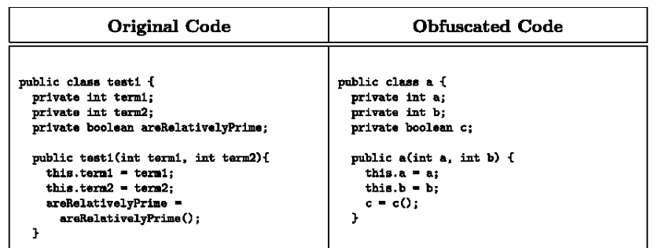
Background - Obfuscation

Slide 12
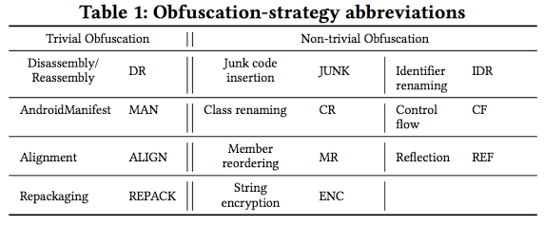
Background - Obfuscation

Slide 13
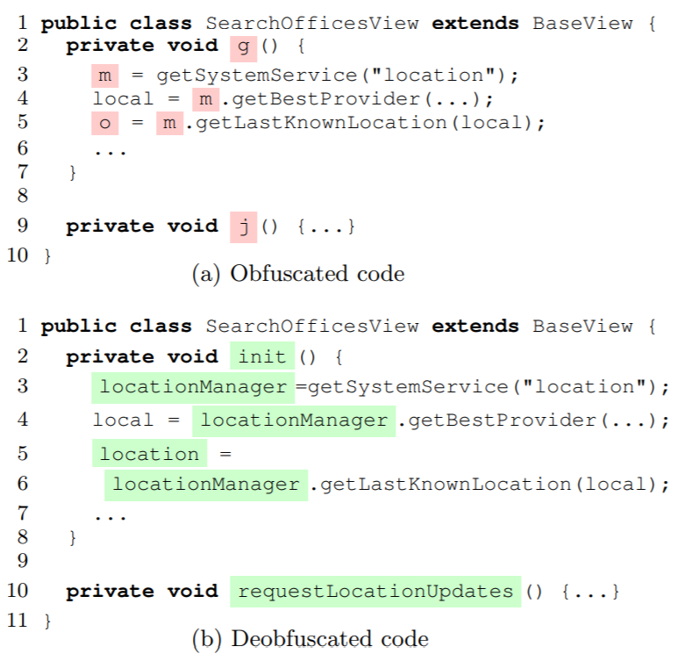
Background - Deobfuscation

Slide 14
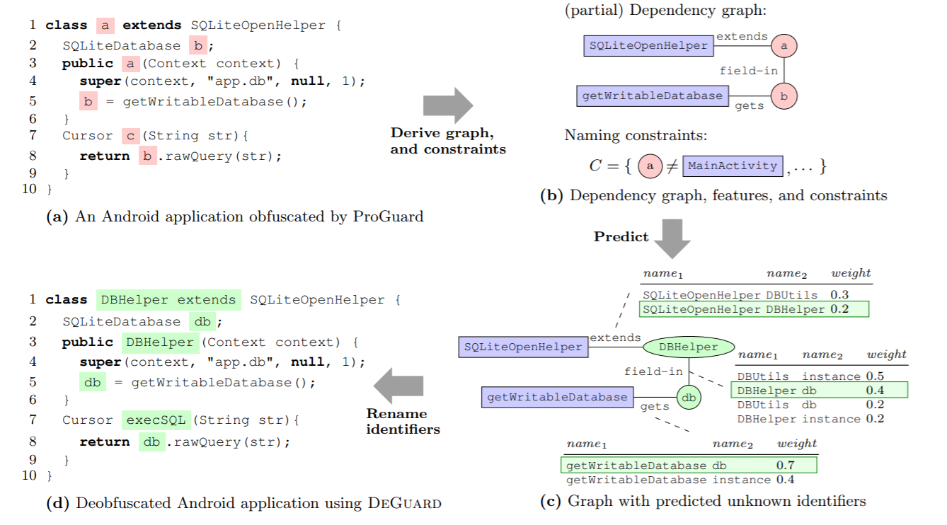
Research Questions

Slide 15
Research Questions
1. How is the accuracy of machine learning detector affected by obfuscation strategy?
2. How is the accuracy of machine learning detector affected by deobfuscation strategy?

Slide 16
Research Questions
2018 – ICSE(A+) - A Large-Scale Empirical Study on the Effects of Code Obfuscations on Android Apps and Anti-Malware Products
RQ1. How is the accuracy of anti-malware products affected by obfuscation strategies?
RQ2. How is the accuracy of anti-malware products affected by obfuscation tools?
RQ3. How is the accuracy of anti-malware products affected by the year an app is created?
RQ4. To what extent do obfuscation tools result in valid, installable, and runnable apps?

Slide 17
Research Questions
2018 - ACSAC(A+) - A Large Scale Investigation of Obfuscation Use in Google Play
RQ1: How many apps are obfuscated, and what techniques are used?
RQ2: What are developers’ awareness, threat models, experiences, and attitudes about obfuscation?
RQ3: How usable is the leading obfuscation tool?

Slide 18
Research Questions
No. | Strategy | No. | Strategy
Ob1 | String | Ob8 | API_Inter
Ob2 | Variable | Ob9 | Ben_Permission
Ob3 | PCM | Ob10 | API_Reflection
Ob4 | Bytecode | Ob11 | RM_Resource_Payload
Ob5 | Benig_Class | Ob12 | RM_APIS
Ob6 | Resource_Image | Ob13 | Rm_Permission
Ob7 | Researce_Xml

Slide 19
Experiments - Virustotal

Slide 20
Experiments - Virustotal
Finding 1 : Code obfuscation significantly impacts Android anti-malware products. The average detection rate for the top anti-malware products decreases from 87% to 67%—a 20% decrease
Finding 2 :String Encryption make apps look suspicious, increasing the chance of an app being labeled as malicious.

Slide 21
Experiments – Machine Learning Detector - Drebin
Finding 3 :For the same type of machine learning detectors of the drebin, the effects of various obfuscation strategies are similar

Slide 22
Experiments – Machine Learning Detector - CSBD
Finding 4 : Various obfuscation strategies have a great impact on the control flow graph (CFG) of the APK file. Will reduce the accuracy of the detector by 85% - 45%.

Slide 23
Experiments – Androguard
Finding 5 : Most of the obfuscation strategies start with code obfuscating from the method level of the code, so it has a big impact on the similarity calculation of this method.

Slide 24
Experiments – Simidroid – component
Finding 6 : A detector that computes similarity at component level is the most resistant to obfuscation strategies.

Slide 25
Experiments – Simidroid – Resource
Finding 7 : Most of the obfuscation strategies have an impact on detecting the detection mechanism of the resource file, even if these policies do not operate on the resource file, and their impact is at the same level.

Slide 26
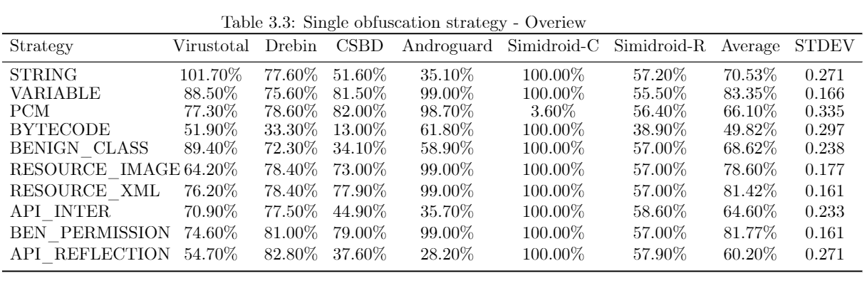
Experiments – Obfuscation Strategies Overview
Finding 8 : If considering the impact on the accuracy of all detectors, the BYTECODE strategy has the greatest impact on all detectors in all strategies. In contrast, the VARIABLE strategy is the one that has the least impact on detector accuracy

Slide 27

Thanks For Your Listening

